Slide 1
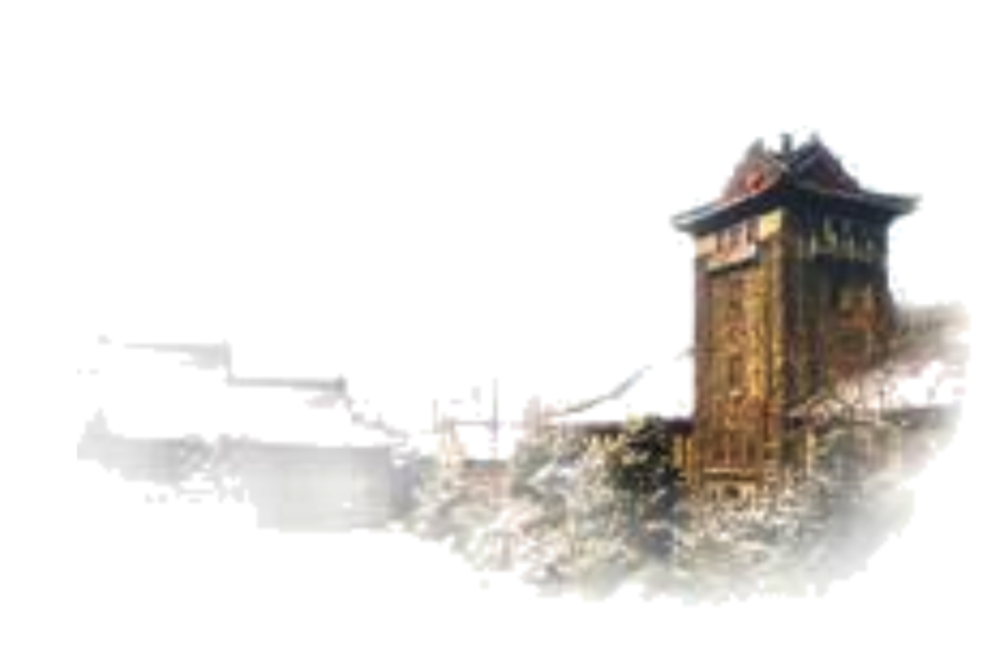
Introduction to Machine Reading Comprehension
Runqi Yang
runqiyang@gmail.com

Slide 2
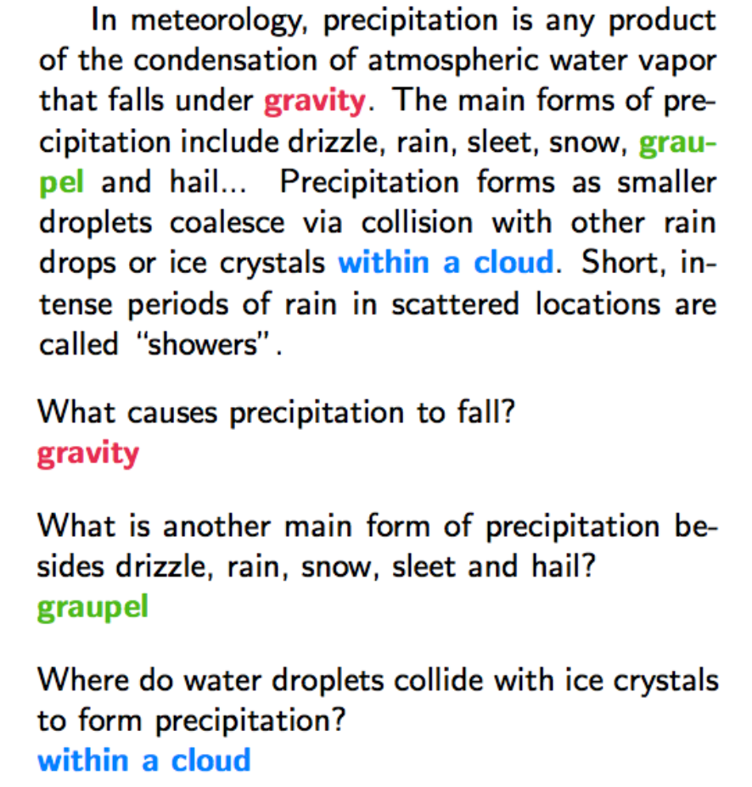
What is reading comprehension?
Provided with one or more pieces of evidence, give the answer to a question.

Slide 3
Difference from other QA settings
General QA: use everything
rules/templates, knowledge bases/dictionaries, raw text, ...
Reading comprehension: a single knowledge source
forces the model to “comprehend”

Slide 4
4 Phases
Small real data/large synthetic data: bAbI, ...
Case study: MemNN
Cloze-style Reading Comprehension: CNN/Daily Mail, CBT, ...
Case study: AoA Reader
Single evidence, a continuous span as the answer: SQuAD, ...
Case study: BiDAF
Multi evidence, no restriction to answers: MS MACRO, Trivia QA, ...
Case study: DrQA

Slide 5
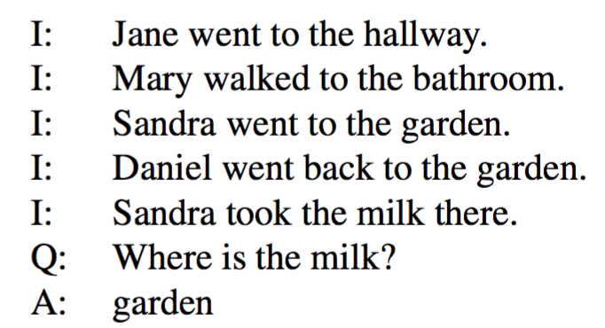
bAbI Dataset
Synthetic data
20 tasks
Single Supporting Fact
Two Supporting Facts
Counting
Simple Negation
Time Reasoning
......
Weston, Jason, et al. "Towards AI-complete question answering: A set of prerequisite toy tasks." (2015).

Slide 6
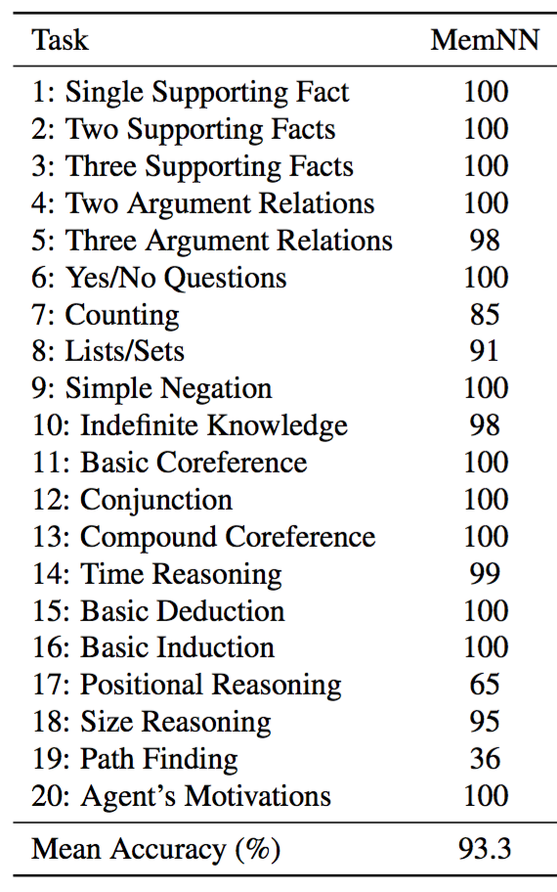
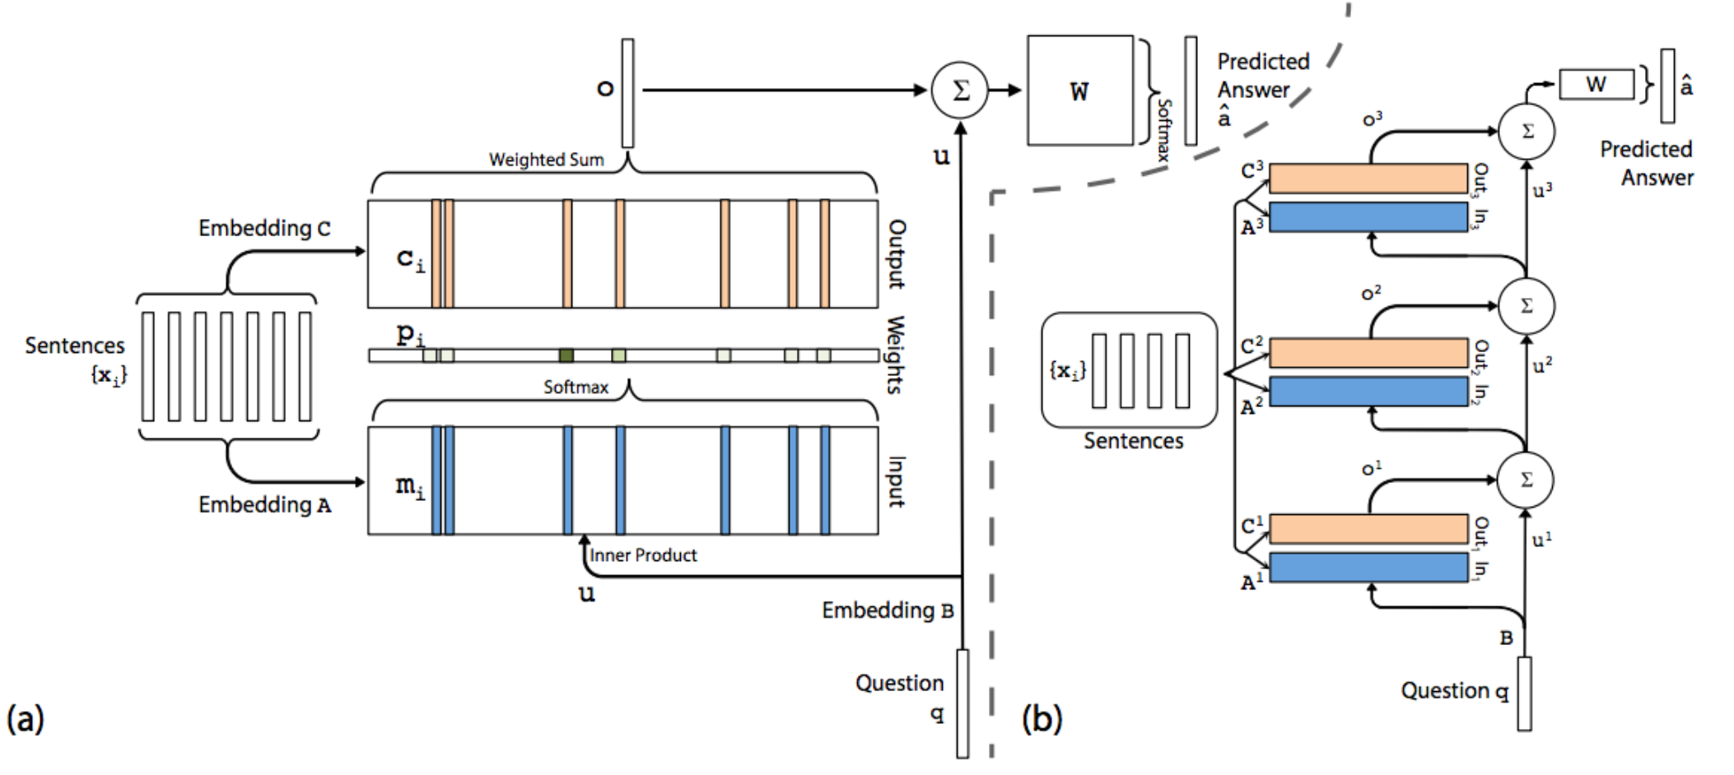
Case study: MemNN

Slide 7
CNN/Daily Mail & CBT
Real data, automatic generated
CNN/Daily Mail: fill in the blank with entity in summary
Children’s Book Test: select to fill in the blank in the next sentence
Large in scale
CNN/Daily Mail: 1.4M Q-A pairs
Children’s Book Test: 688K Q-A pairs
Not natural

Slide 8
CNN/Daily Mail-example

Slide 9
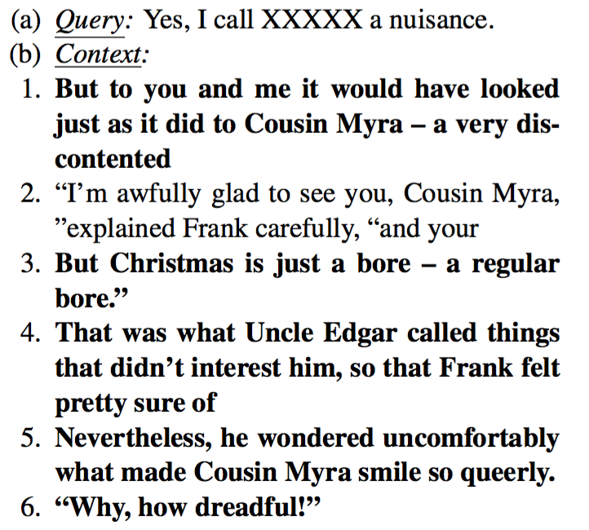
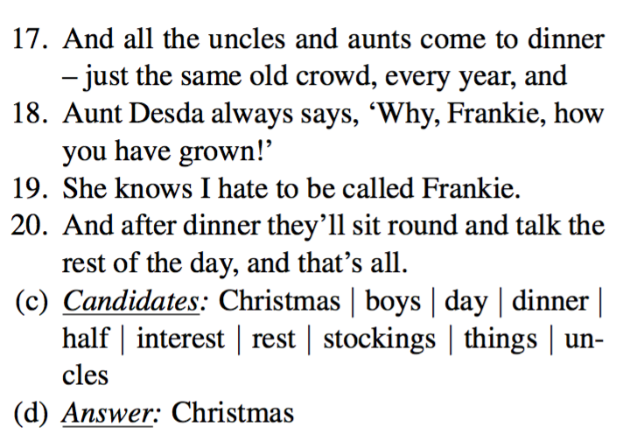
Children’s Book-example

Slide 10
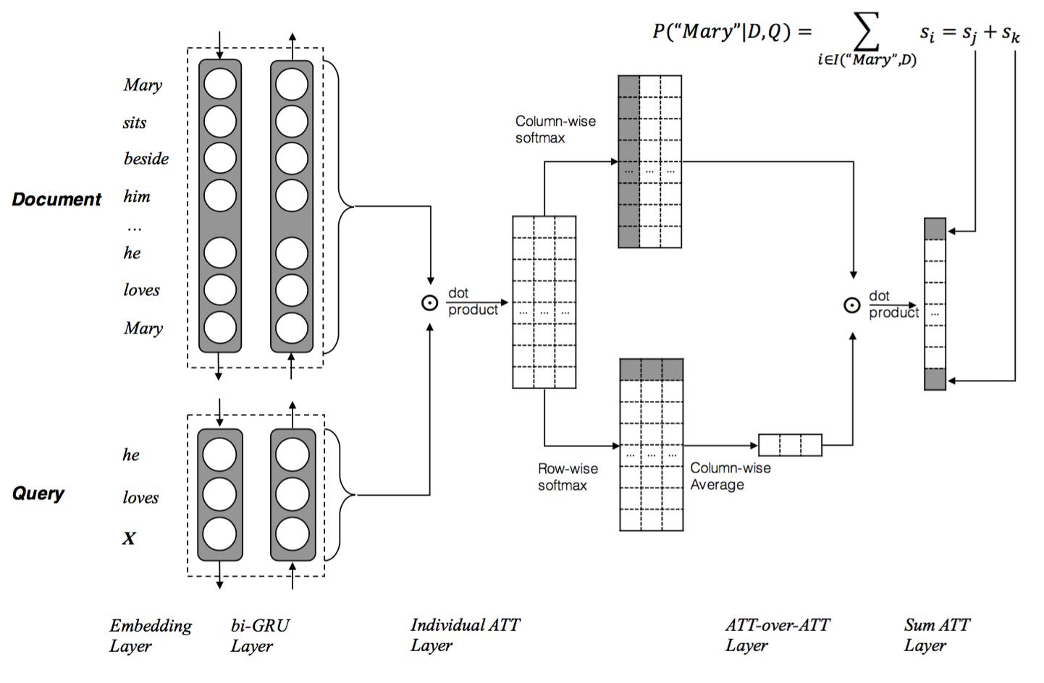
Case study: AoA Reader

Slide 11
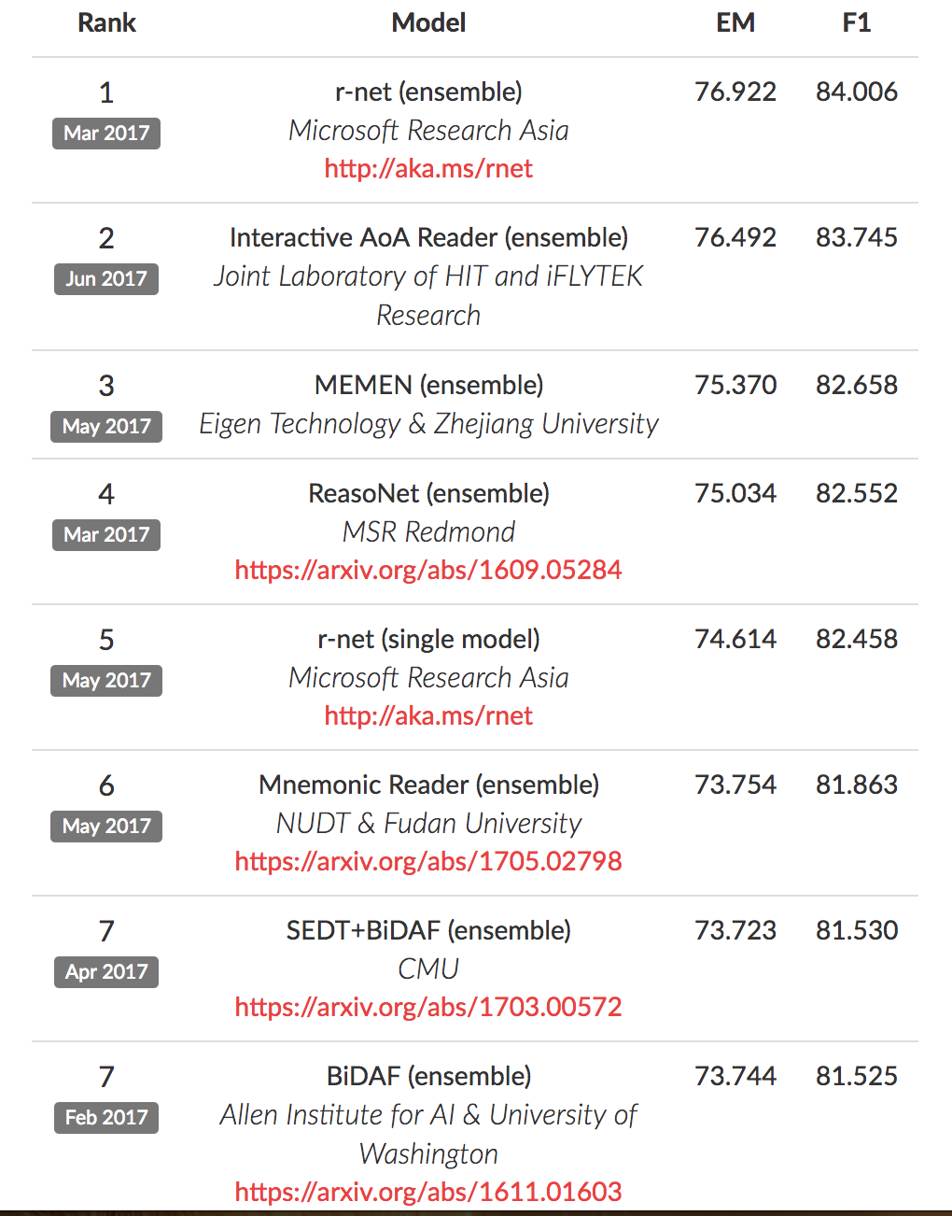
SQuAD
“ImageNet in NLP”
Hidden test set with leaderboard
From Wikipedia, human-labeled
Human generated question, a continuous span as the answer
Evaluation: EM & F1
$≥3$ answers in dev & test set
Human performance: EM 82%, F1 91%
Rajpurkar, Pranav, et al. "Squad: 100,000+ questions for machine comprehension of text." (2016).

Slide 12
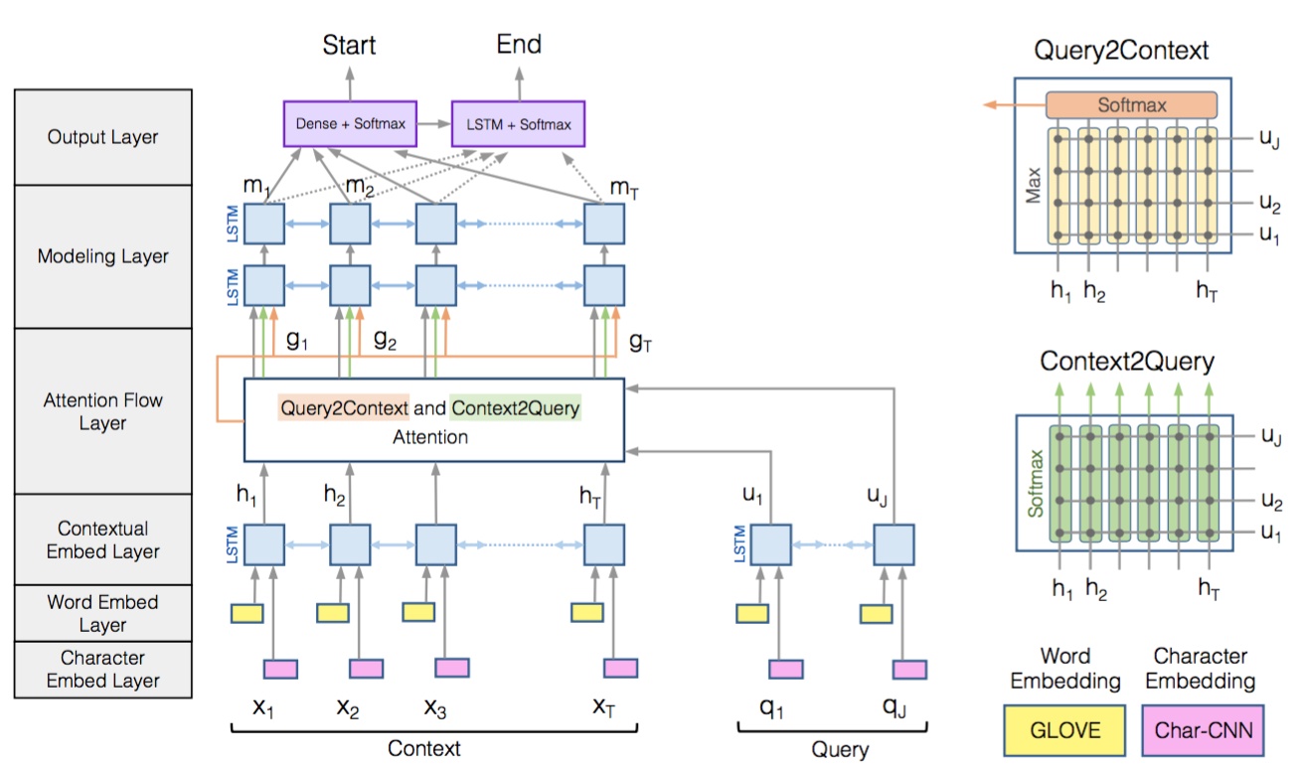
Case study: BiDAF

Slide 13
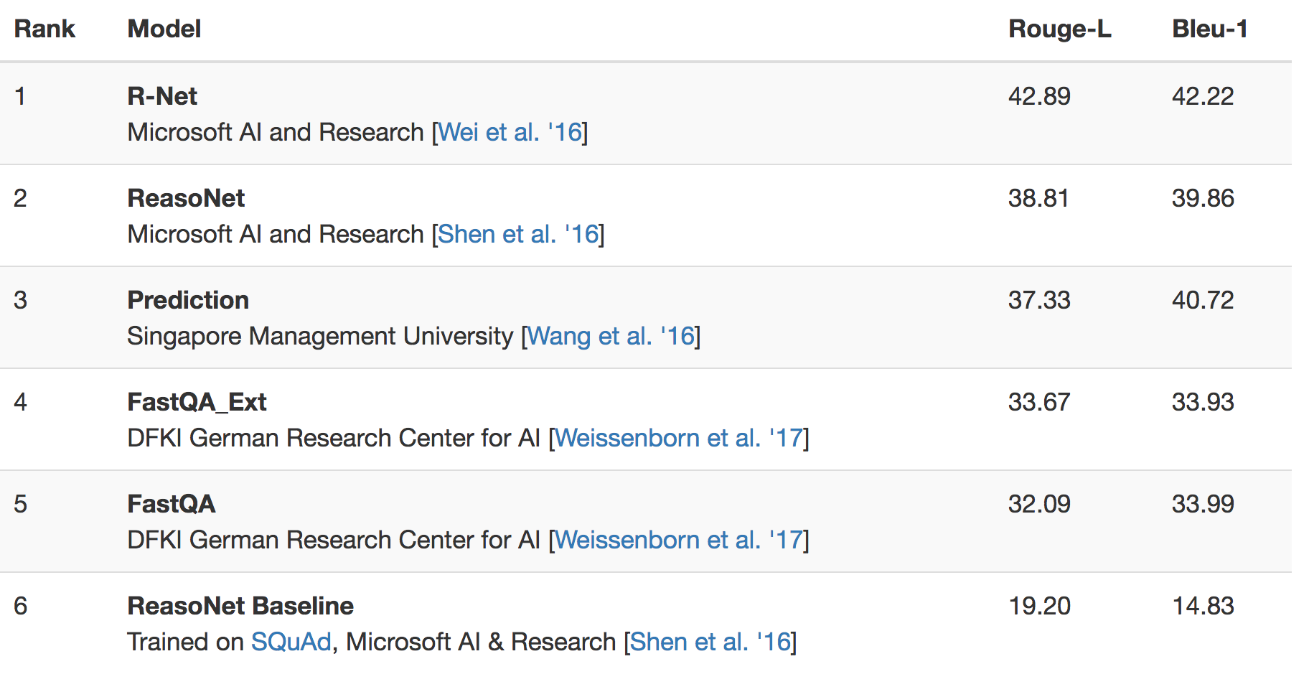
MS MACRO
More diverse passages
100K queries, the same as SQuAD
#documents: 200K+ vs 536
Natural QA
Questions from user log
Answers not limited to span
Evaluation: Rouge-L & Bleu-1
human performace: 47, 46
Nguyen, Tri, et al. "MS MACRO: A human generated machine reading comprehension dataset." (2016).

Slide 14
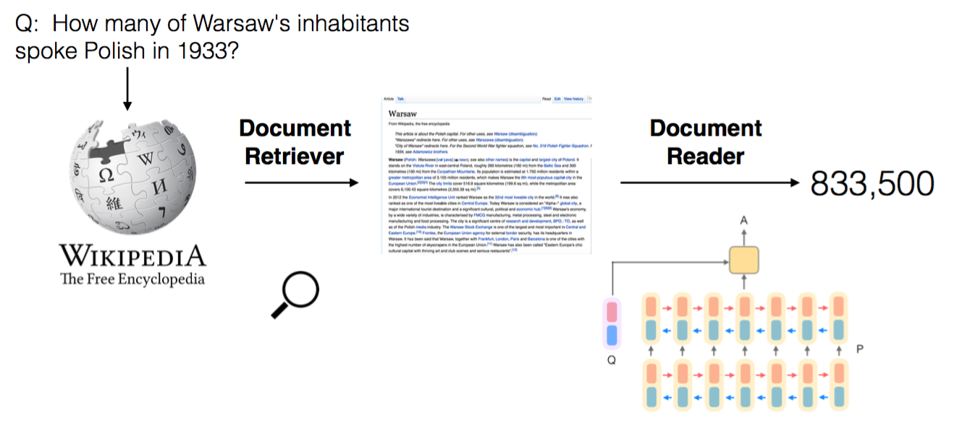
Case study: DrQA

Slide 15
Case study: DrQA-Retriever
Baseline
Wikipedia Search API: TF-IDF weighted BOW vectors
Improvement
Hashed Bigram

Slide 16
Case study: DrQA-Reader (1)
Paragraph Embedding
GloVe vectors
exact match
POS, NER, normalized TF
aligned question embedding: project-dot-softmax-weighted average
Paragraph Encoding
3-layer BiLSTM
Question Encoding
3-layer BiLSTM + attention pooling

Slide 17
Case study: DrQA-Reader (2)
Answer Prediction
bilinear score (unnormalized exponential):
find the answer span:
take argmax over all considered paragraph spans for the final prediction.

Slide 18
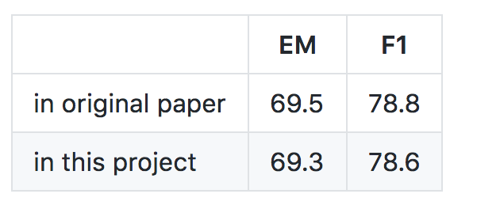
Implementation of DrQA
https://github.com/hitvoice/DrQA

Slide 19
Reference
Weston, Jason, et al. "Towards ai-complete question answering: A set of prerequisite toy tasks." arXiv preprint arXiv:1502.05698 (2015).
Hermann, Karl Moritz, et al. "Teaching machines to read and comprehend." Advances in Neural Information Processing Systems. 2015.
Hill, Felix, et al. "The Goldilocks Principle: Reading Children's Books with Explicit Memory Representations." arXiv preprint arXiv:1511.02301(2015).
Nguyen, Tri, et al. "Ms marco: A human generated machine reading comprehension dataset." arXiv preprint arXiv:1611.09268 (2016).
Rajpurkar, Pranav, et al. "Squad: 100,000+ questions for machine comprehension of text." arXiv preprint arXiv:1606.05250 (2016).
Sukhbaatar, Sainbayar, Jason Weston, and Rob Fergus. "End-to-end memory networks." Advances in neural information processing systems. 2015.
Cui, Yiming, et al. "Attention-over-attention neural networks for reading comprehension." arXiv preprint arXiv:1607.04423 (2016).
Seo, Minjoon, et al. "Bidirectional attention flow for machine comprehension." arXiv preprint arXiv:1611.01603 (2016).
Chen, Danqi, et al. "Reading Wikipedia to Answer Open-Domain Questions." arXiv preprint arXiv:1704.00051 (2017).

